Slide 1


Insurance Project
This presentation explores our data quality strategy, a critical element of our project's success. From extracting and integrating data to rigorous analysis and cleaning, we ensured a reliable foundation for accurate results and informed decisions.
by Aishwarya Sonawane

Slide 2
Data Extraction: Challenges and Solutions
Challenges
Solutions
Extracting data from a Microsoft SQL Server database presented several challenges: high data volume, complex relationships between tables, potential performance impact on the server, and security concerns.
We addressed these challenges by employing optimized SQL queries, utilizing tools like SSIS, implementing incremental extraction, and applying data masking and encryption techniques.

Slide 3

Data Integration: Combining Policy and Claim Data
Inconsistent Naming Conventions
Different systems often use inconsistent naming conventions for the same information, making data integration challenging.
Data Type Discrepancies
Variations in data types, such as date or address formats, can hinder the integration process.
Missing Data
Handling missing data, such as missing customer information in claims data, requires careful consideration.
Data Duplication
Duplicate records across sources, like customer records appearing in both policy and claims data, need to be addressed.

Slide 4

Data Quality Analysis: Identifying Issues
Completeness
We measured the percentage of missing values in critical fields, aiming for a completeness rate of over 95%.
Accuracy
We validated data against known standards or reference datasets, striving for an accuracy rate exceeding 98%.
Consistency
We ensured uniformity of data across different sources, targeting 100% consistency in date formats, currency symbols, etc.
Validity
We verified that data adhered to predefined data types and constraints, aiming for 100% validity.

Slide 5
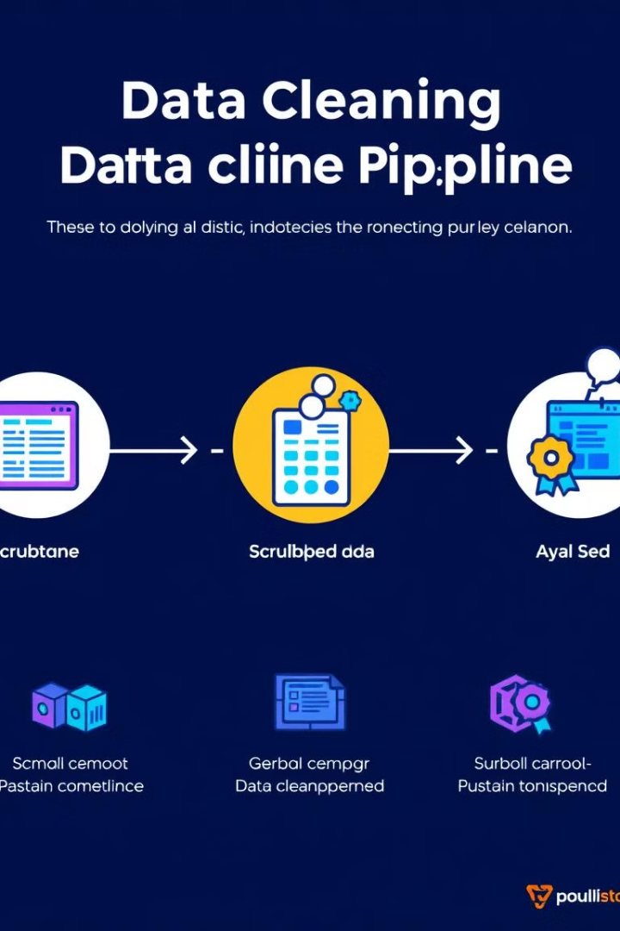




Data Cleaning: Rectifying Errors and Inconsistencies
Imputation
Correction
Standardization
We imputed missing values using statistical methods or domain expertise.
We corrected inaccurate data using external reference data or manual review.
We standardized inconsistent data formats using predefined rules or lookup tables.
Deduplication
We removed duplicate records using data deduplication algorithms.

Slide 6

Validation and Testing
1
Data Validation Checks
We performed data validation checks to ensure data conformed to predefined rules and constraints.

Slide 7

Conclusion: High-Quality Data, Reliable Results
We successfully extracted, integrated, analyzed, and cleaned the data. This high-quality data enables improved accuracy, enhanced decision-making, and increased confidence in our project outcome.

